Slide 1
Plant Leaf Health
Hammad Sheikh

Slide 2
Project Information
Title: Plant Leaf Health
Group Members: Self
Data Source: A Database of Leaf Images: Practice towards plant Conservation with Plant Pathology, Siddharth Singh Chouhan, Ajay Kaul, Uday Pratap Singh, Sanjeev Jain. DOI: 10.17632/hb74ynkjcn.5
Obtained from Mendeley Data
Notes:
Data Source Citation: Chouhan, Siddharth Singh; Kaul, Ajay; Singh, Uday Pratap; Jain, Sanjeev (2022), “A Database of Leaf Images: Practice towards Plant Conservation with Plant Pathology”, Mendeley Data, V5, doi: 10.17632/hb74ynkjcn.5

Slide 3
Rationale
This project is important to me because I really enjoy gardening. I actively maintain my garden, and I always have to be mindful of the health of my plants and provide continuous care to ensure they remain healthy. What I currently struggle with is the state of the plants’ health. That is, I am overly cautious which results in me over-providing for my plants, whether it be water, sun, shade, fertilizer, or pesticide or whatever else, and this is not good as the plants will become dependent upon my care and wither in my absence – yes, this does and can happen. I hope to build a program that I can actively use to gauge my plants' health and provide appropriate and better care to ensure my plants live a healthy long lasting life.

Slide 4
Objective(s)
The objective of this project is to create a model and setup that is able to intake a plant's leaf image and categorize both its species and health via comparison to publicly available dataset and models.
Ideal goal: for the model to identify the disease for an unhealthy plant and steps/methods to cure

Slide 5
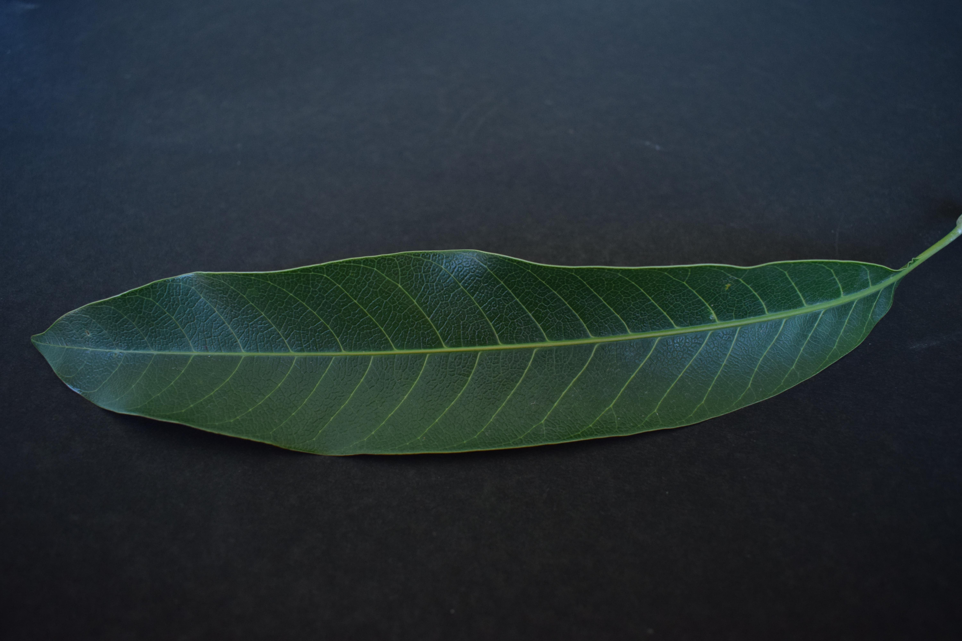
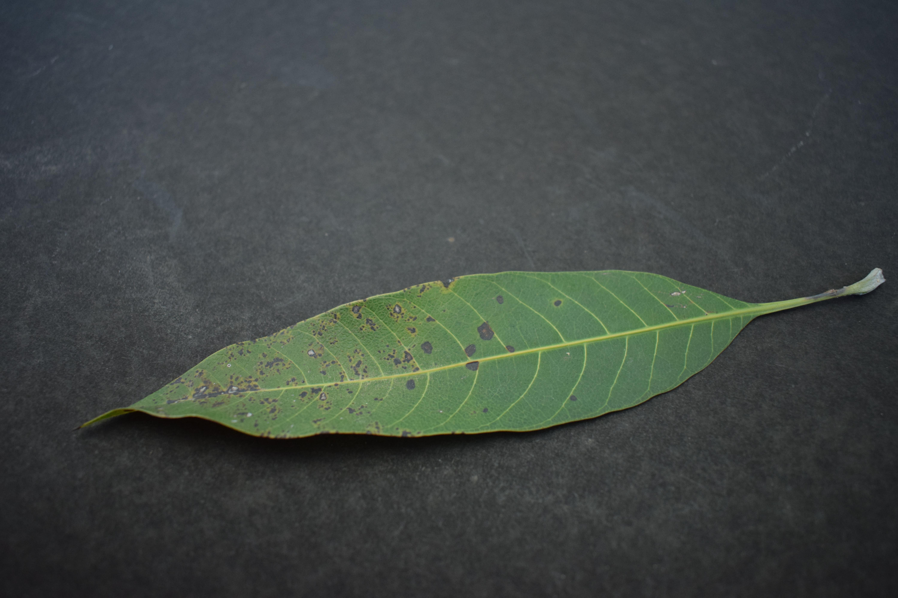
Dataset Sample Images
Healthy Mango Leaf
Unhealthy Mango Leaf

Slide 6
Proposed Approaches
Current proposed approach is similar to the approach taken in “A statistical approach to identify diseased leaf from healthy”, E. Priya, N. Dhanavarsha, S. V. Gayathri, N. Pavithra.
Import the images into the program
Compress the images
Convert to gray scale
Enhance contrast
Texture/Significant features – this is where the bulk of the model would be, including training and validation
Categorization of healthy vs diseased
Model will be trained using existing dataset.
It will be tested with pictures from my garden, primarily mango and lemon

Slide 7
Potential Issues/Concerns
Noise Control – environment and surroundings
Differentiating leaves
Whether it is a bunch (multiple leaves) of the same type
If multiple different types are bunched together
Size of images and what image features to really limit to
Hoping for this to be resolved with the ML model
Dataset images resolution information;
The images are captured in a closed environment with Nikon D5300 camera – with inbuilt performance timing for shooting JPEG in single shot mode, 18-55mm lens, 24-bit depth, 2 resolution unit, 1000-ISO, and no flash.
The dataset has only 12 classes – plant types

Slide 8
The End

